Slide 1
Amazon Review Classifier
Siqi Li
Dec 3, 2020
Classifying Amazon video reviews through machine learning and deep learning models

Slide 2
Problem Statement
Text classification
Assigning tags or categories to text based on its content
One of the fundamental tasks in natural language processing (NLP).
Trained 3 machine learning models and 2 deep learning models and evaluated their performances using Amazon video review data.

Slide 3
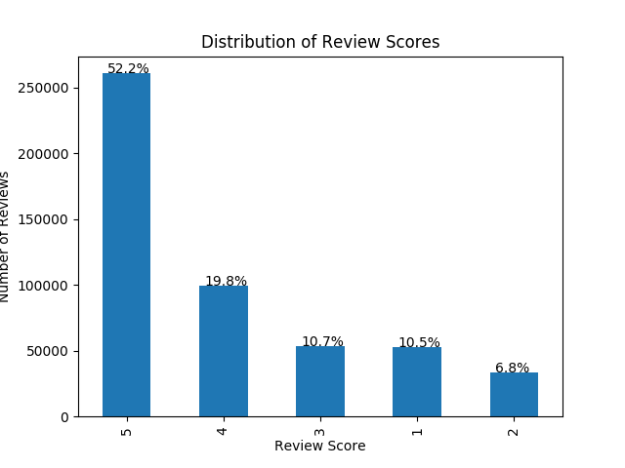
Data
Summary Statistics
Number of Reviews | 500,000
Average Length of Reviews | 775.50
Standard Deviation of Length of Reviews | 984.28
Minimum Length of Reviews | 1
Length of Reviews (25 percentiles) | 191
Length of Reviews (50 percentiles) | 422
Length of Reviews (75 percentiles) | 948
Maximum Length of Reviews | 31,713
Data Source:
Amazon video review data
500,000 reviews and review scores

Slide 4
Models
Machine Learning Models
Logistic regression model with TF-IDF
Support vector machine model with TF-IDF
Multinomial Naïve Bayes model with TF-IDF
Deep Learning Models
BERT model
LSTM model
One-directional LSTM
Bidirectional LSTM
Bidirectional LSTM with self-attention

Slide 5
Model Training
Preprocess Raw Text
Removed special characters
Removed numbers
Removed English stop-words
Removed extract spaces
Converted texts to lower cases
Train / Test Split
80% of data for training
20% of data for testing

Slide 6
Model Evaluation
Model | Accuracy | Rank
BERT | 0.7580 | 1
SVM | 0.7284 | 2
Bi-LSTM with Self-Attention | 0.7091 | 3
LSTM | 0.6980 | 4
Bi-LSTM | 0.6970 | 5
Logistic Regression | 0.6827 | 6
Multinomial Naïve Bayes | 0.6197 | 7

Slide 7
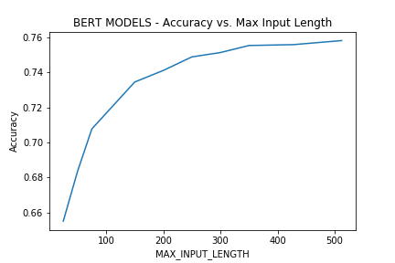
Insights
Deep learning models don’t always perform better than do machine learning models, and deep learning models require more fine-tunning.
For BERT, the greater the max input length, the better it performed.
BERT had the best performance, but it required a much longer time to train (6 hours per epoch). SVM is the 2nd best model, and its entire training only took 35 minutes.

Slide 8
Web App Demo
What is the predicted rating for review: “This is the best movie of this type that I have ever seen”?

Slide 9
Thank you!
Siqi Li
Northwestern MSiA Class of 2020
LinkedIn: https://www.linkedin.com/in/siqi-li-0115/
Github: https://github.com/LSQI15/MSiA490-AmazonReviewTextClassification

